Slide 1
Simulation of evolving plant communities
Project for „Practicum on Mathematical Modelling“
Faculty of Mathematics and Informatics, Sofia University “St. Kliment Ohridski”

Slide 2
Submitted by
25612, Dimitar Valentin Trendafilov, dimitar.trendafilov94@gmail.com
Computational Mathematics and Mathematical Modelling
Project guide: Prof. Tihomir Ivanov
Date: 23.04.2018

Slide 3
Agenda
Inspiration
Research
The Current Model
Progress
Notes
Future Work
References

Slide 4
Inspiration

Slide 5
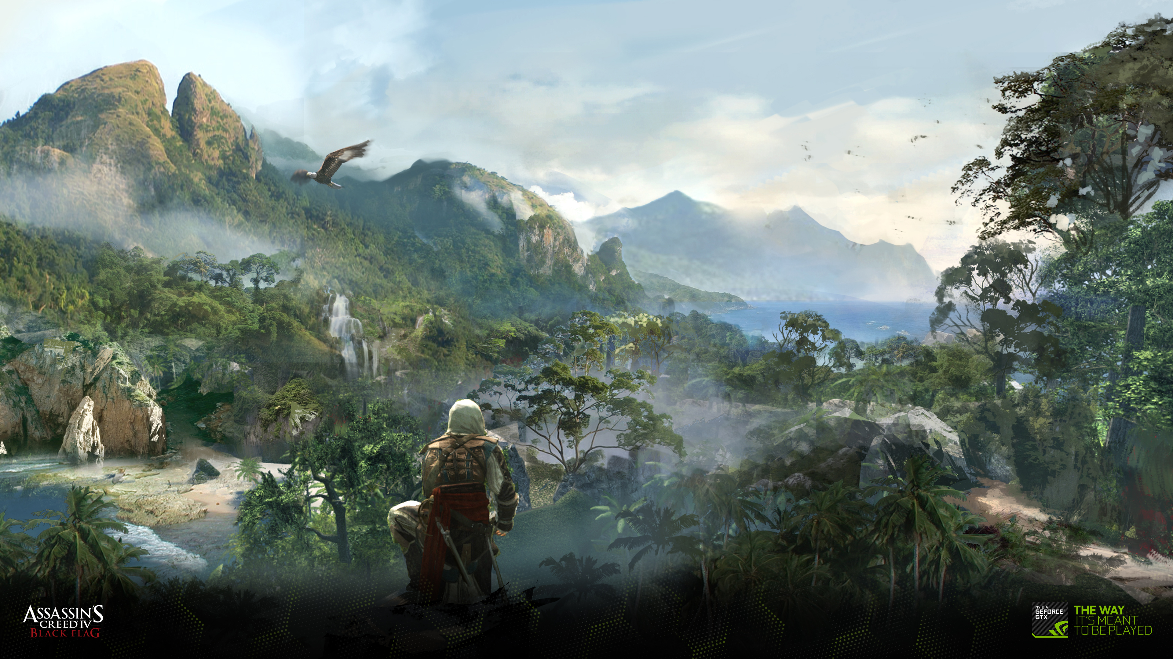
Assassin's Creed IV: Black Flag

Slide 6
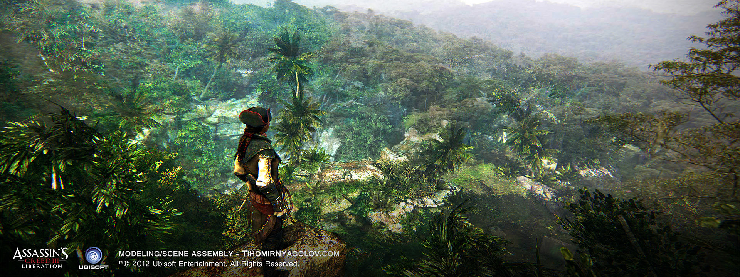
Assassin's Creed III: Liberation

Slide 7
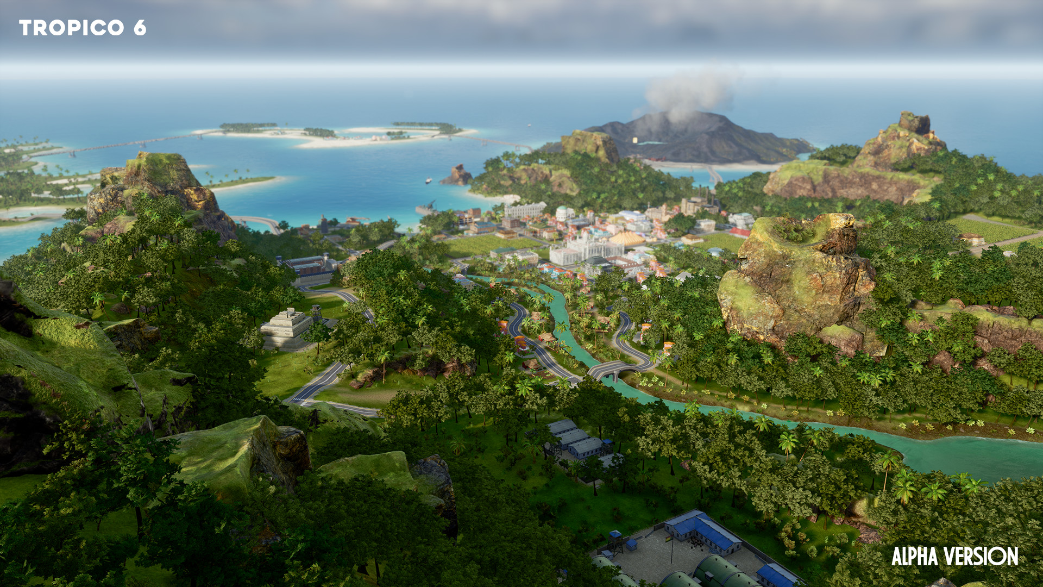
Tropico 6

Slide 8
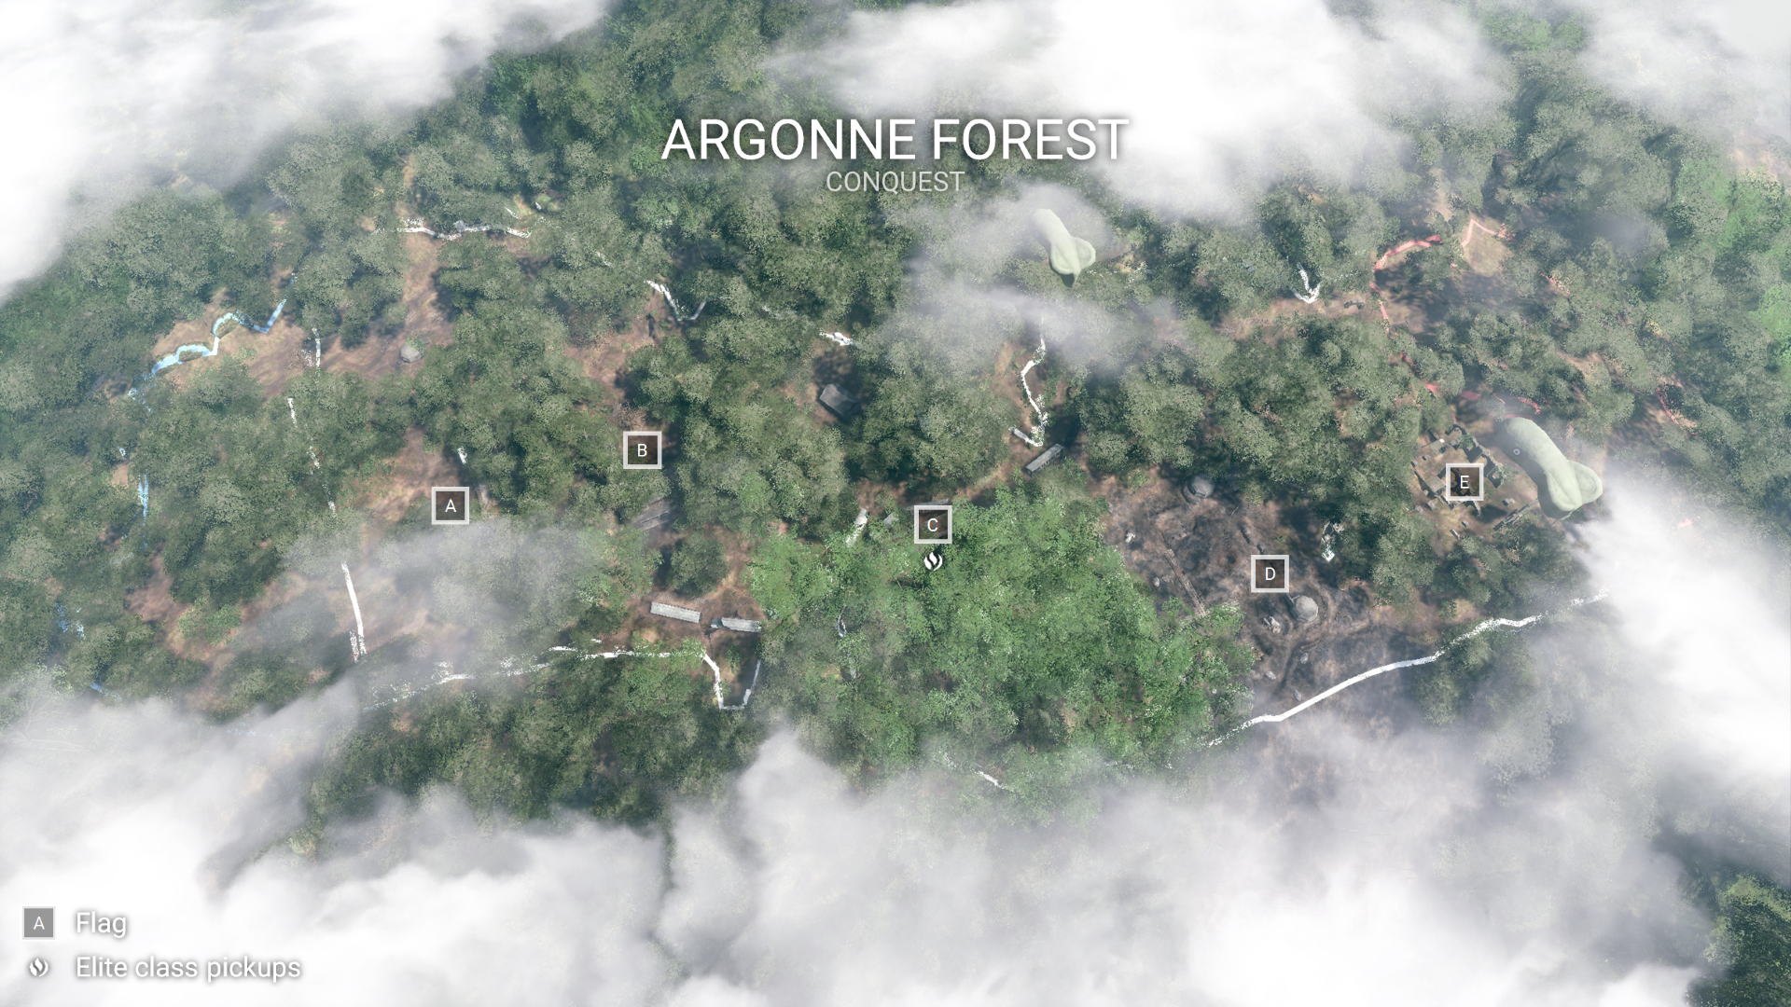
Battlefield 1

Slide 9
Procedural Plant Communities
Pros
Cons
Less level designer time
Less artist time
More consistency
More compact representation
Have to learn new technology
Have to write software
New resource data
Unpredictability

Slide 10
Research
Cellular automata [SCH08]
Good starting point
Looked into existing systems [DHL98]
Gave the idea for representing plants as spheres
Searched through references

Slide 11
The Current Model
Modeling and Visualization of symmetric and asymmetric plant competition[AD05]

Slide 12
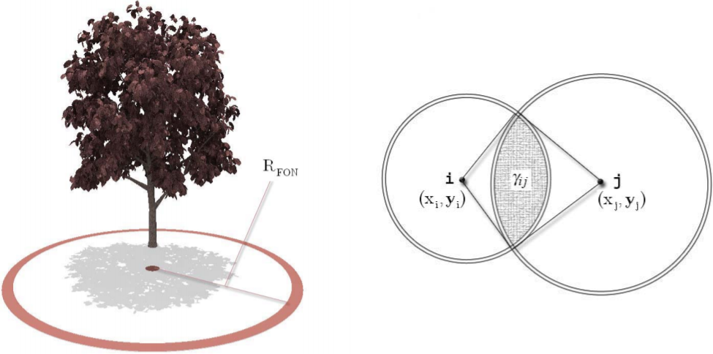
Idea
Field-of-neighbourhood (R_{FON})
Symmetric competition (σ_{ij})
Asymmetric competition (α_{ij})
Weighted combination (ϕ_{i})

Slide 13
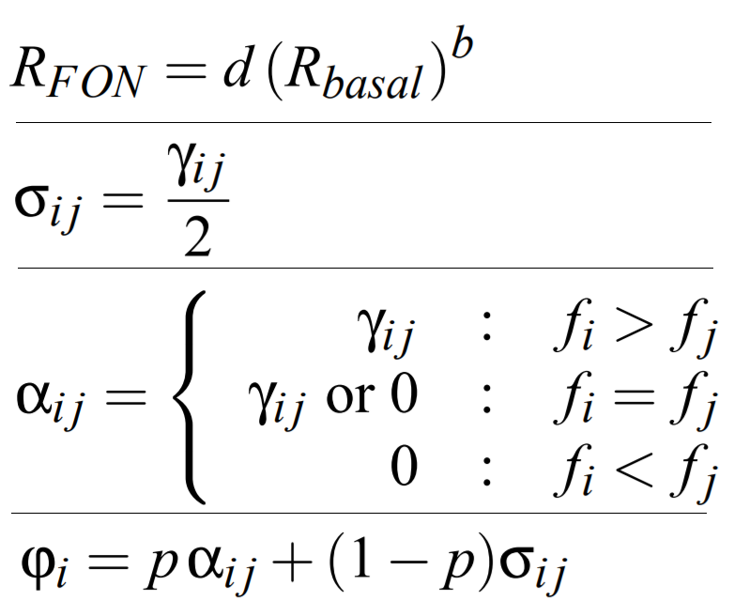
Formulas

Slide 14
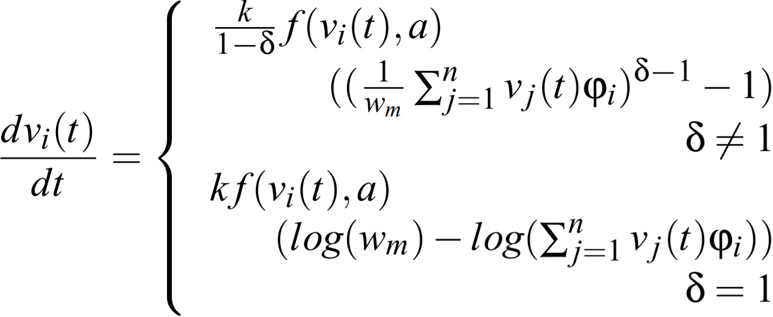
Richards growth model

Slide 15
Numerical methods
3rd and 4th Order Runge-Kutta
Currently used method
Maddeningly slow
Euler’s Explicit Method
Will be implemented for smaller iteration times
Adams‘ Explicit Method
Will be implemented for benchmark
Use instead of listed above based on results
Predictor–corrector method
Last resort if Adams’ method and Euler method fail

Slide 16
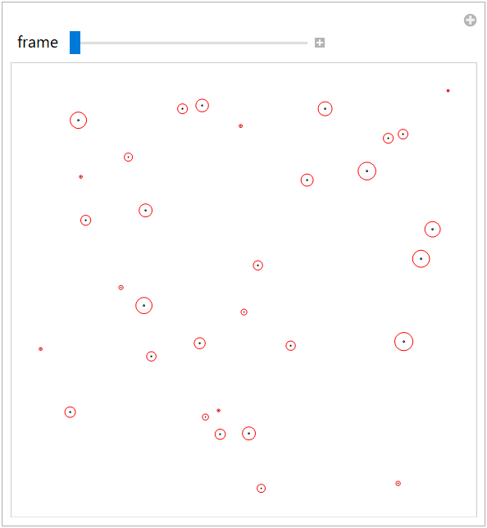
Progress
Plants: 32
Species: 1
Black circles: Basal
Red circles: FON

Slide 17
TODO
Arbitrary time interval length (currently only resolution control)
Plant mortality
Plant reproduction
Maximum plant size
Nutrients simulation
Optimizations

Slide 18
Future Work
Shallow water equations/model
Sun shadowing
Actual rendering

Slide 19
References
[SCH08] Joel L. Schiff, “Cellular Automata A Discrete View of the World” Wiley, 2008
[DHL98] Oliver Deussen, Pat Hanrahan, Bernd Lintermann, “Realistic modeling and rendering of plant ecosystems” SIGGRAPH 1998: Orlando, FL, USA
[AD05] M. Alsweis and O. Deussen, „Modeling and Visualization of symmetric and asymmetric plant competition“ KOPS, 2005

Slide 20
Questions
?
?
?
?
?
?
?
?
?
?
?
?
?
?
?
?
?

Slide 21
Thank you for your attention ☺

